Slide 1
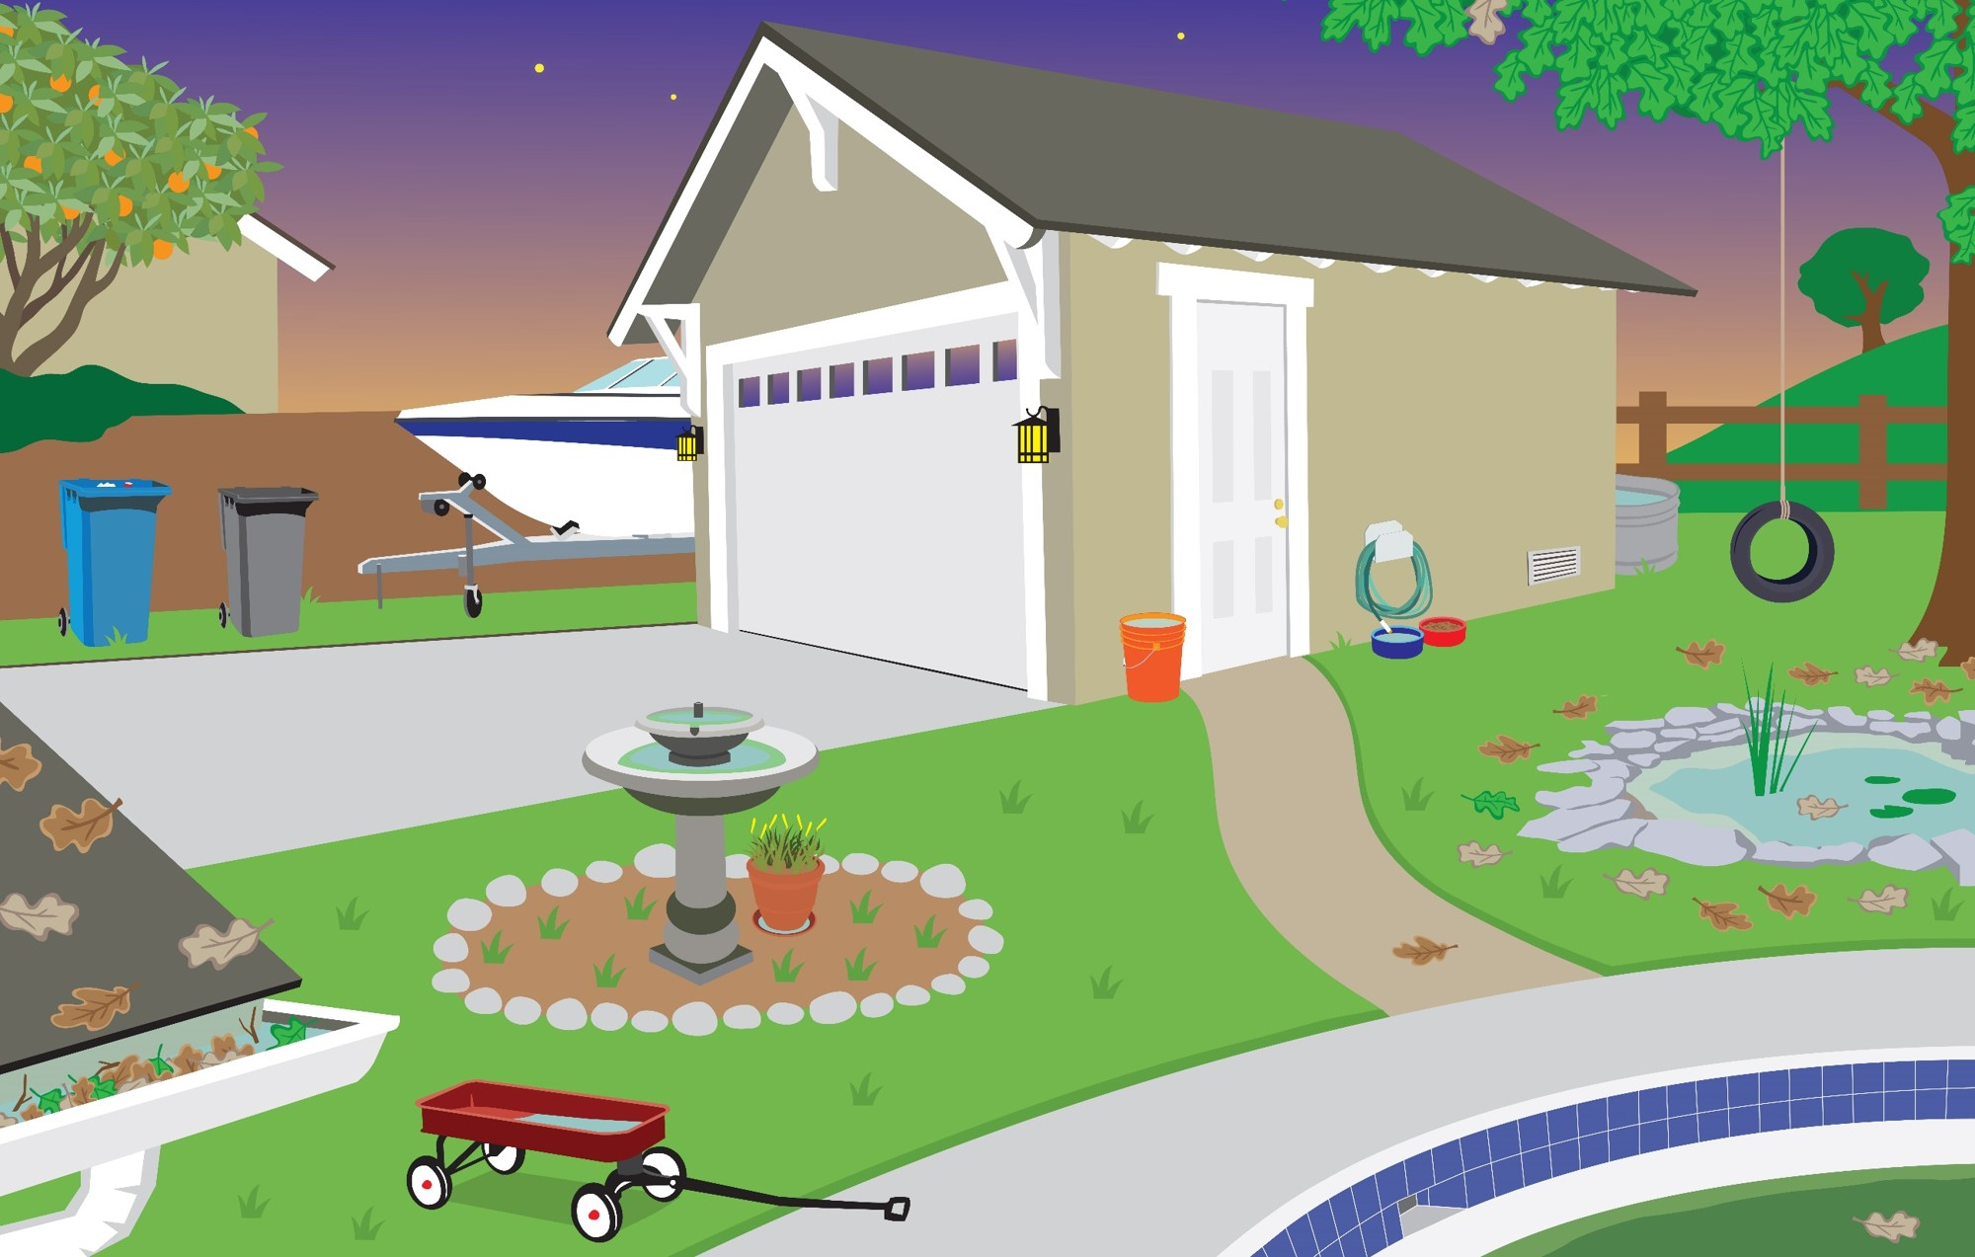
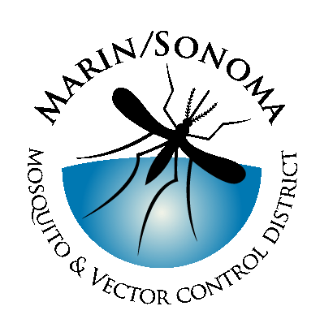
Living with
Mosquitoes
Notes:
Intro self, MSMVCD. Why are mosquitoes considered vectors? Like it or not, we share a habitat with bloodthirsty bugs so we should learn all we can about how to stop them from becoming too numerous, limiting the harm they could do.

Slide 2
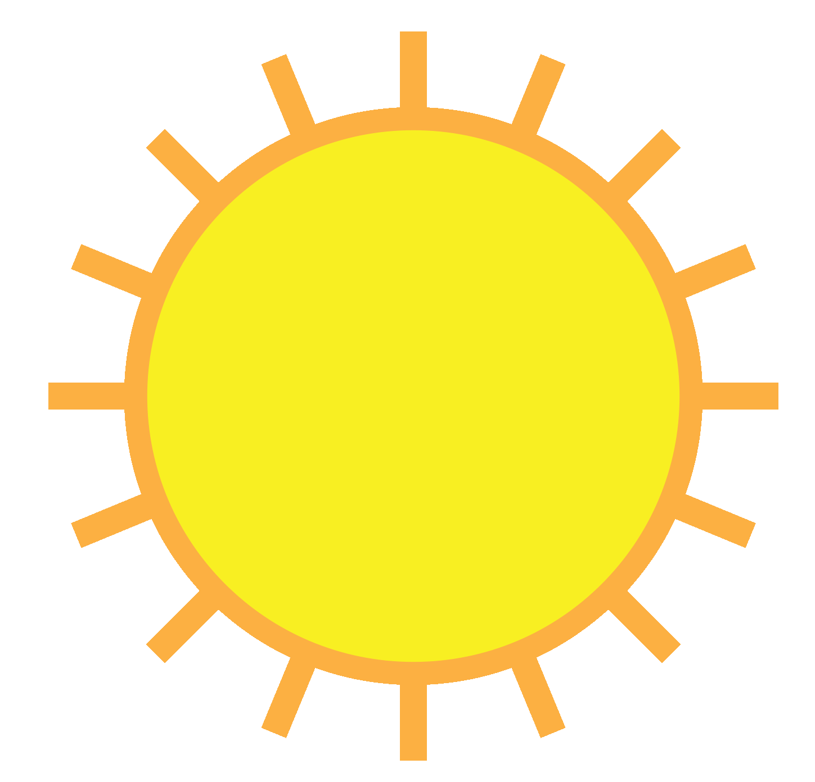

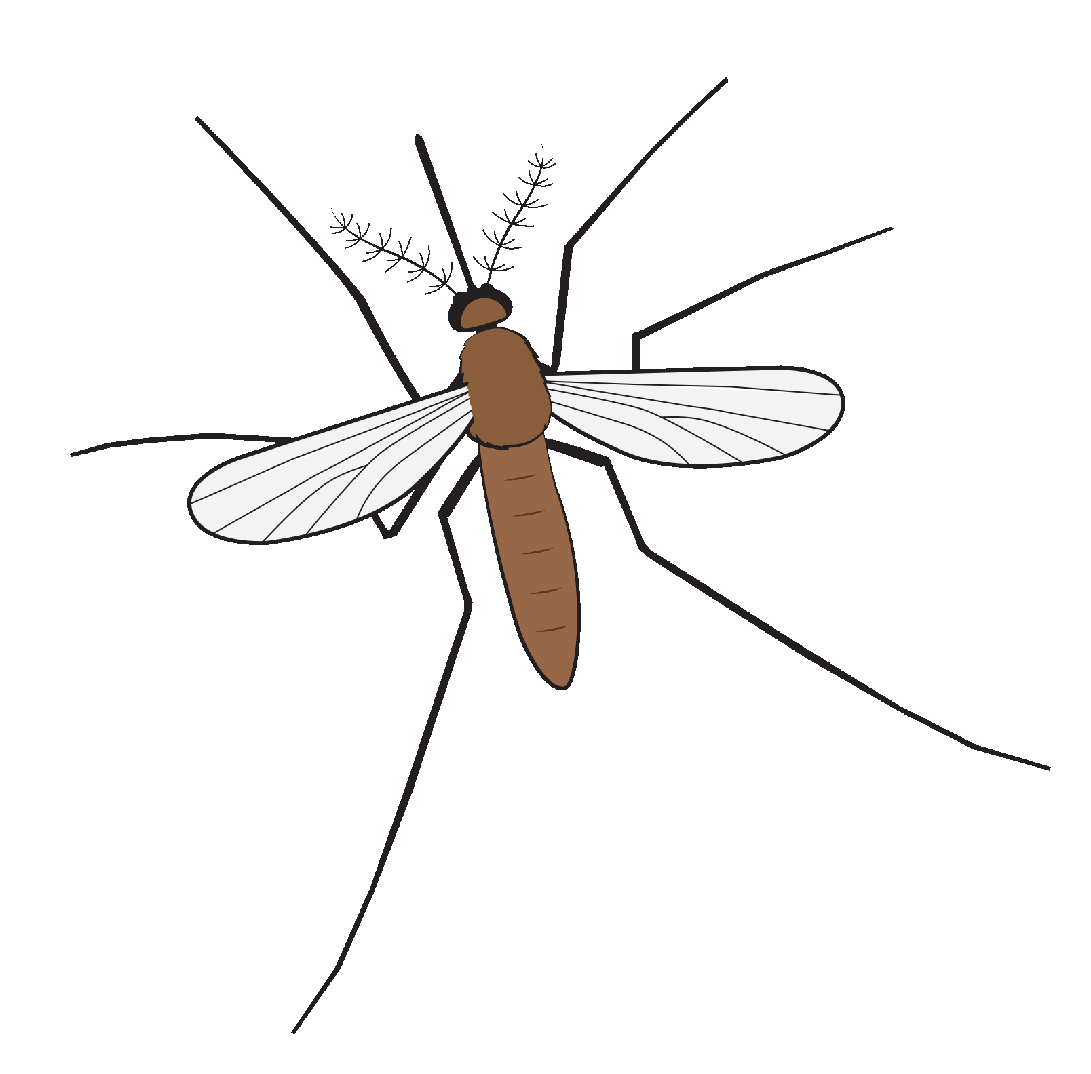


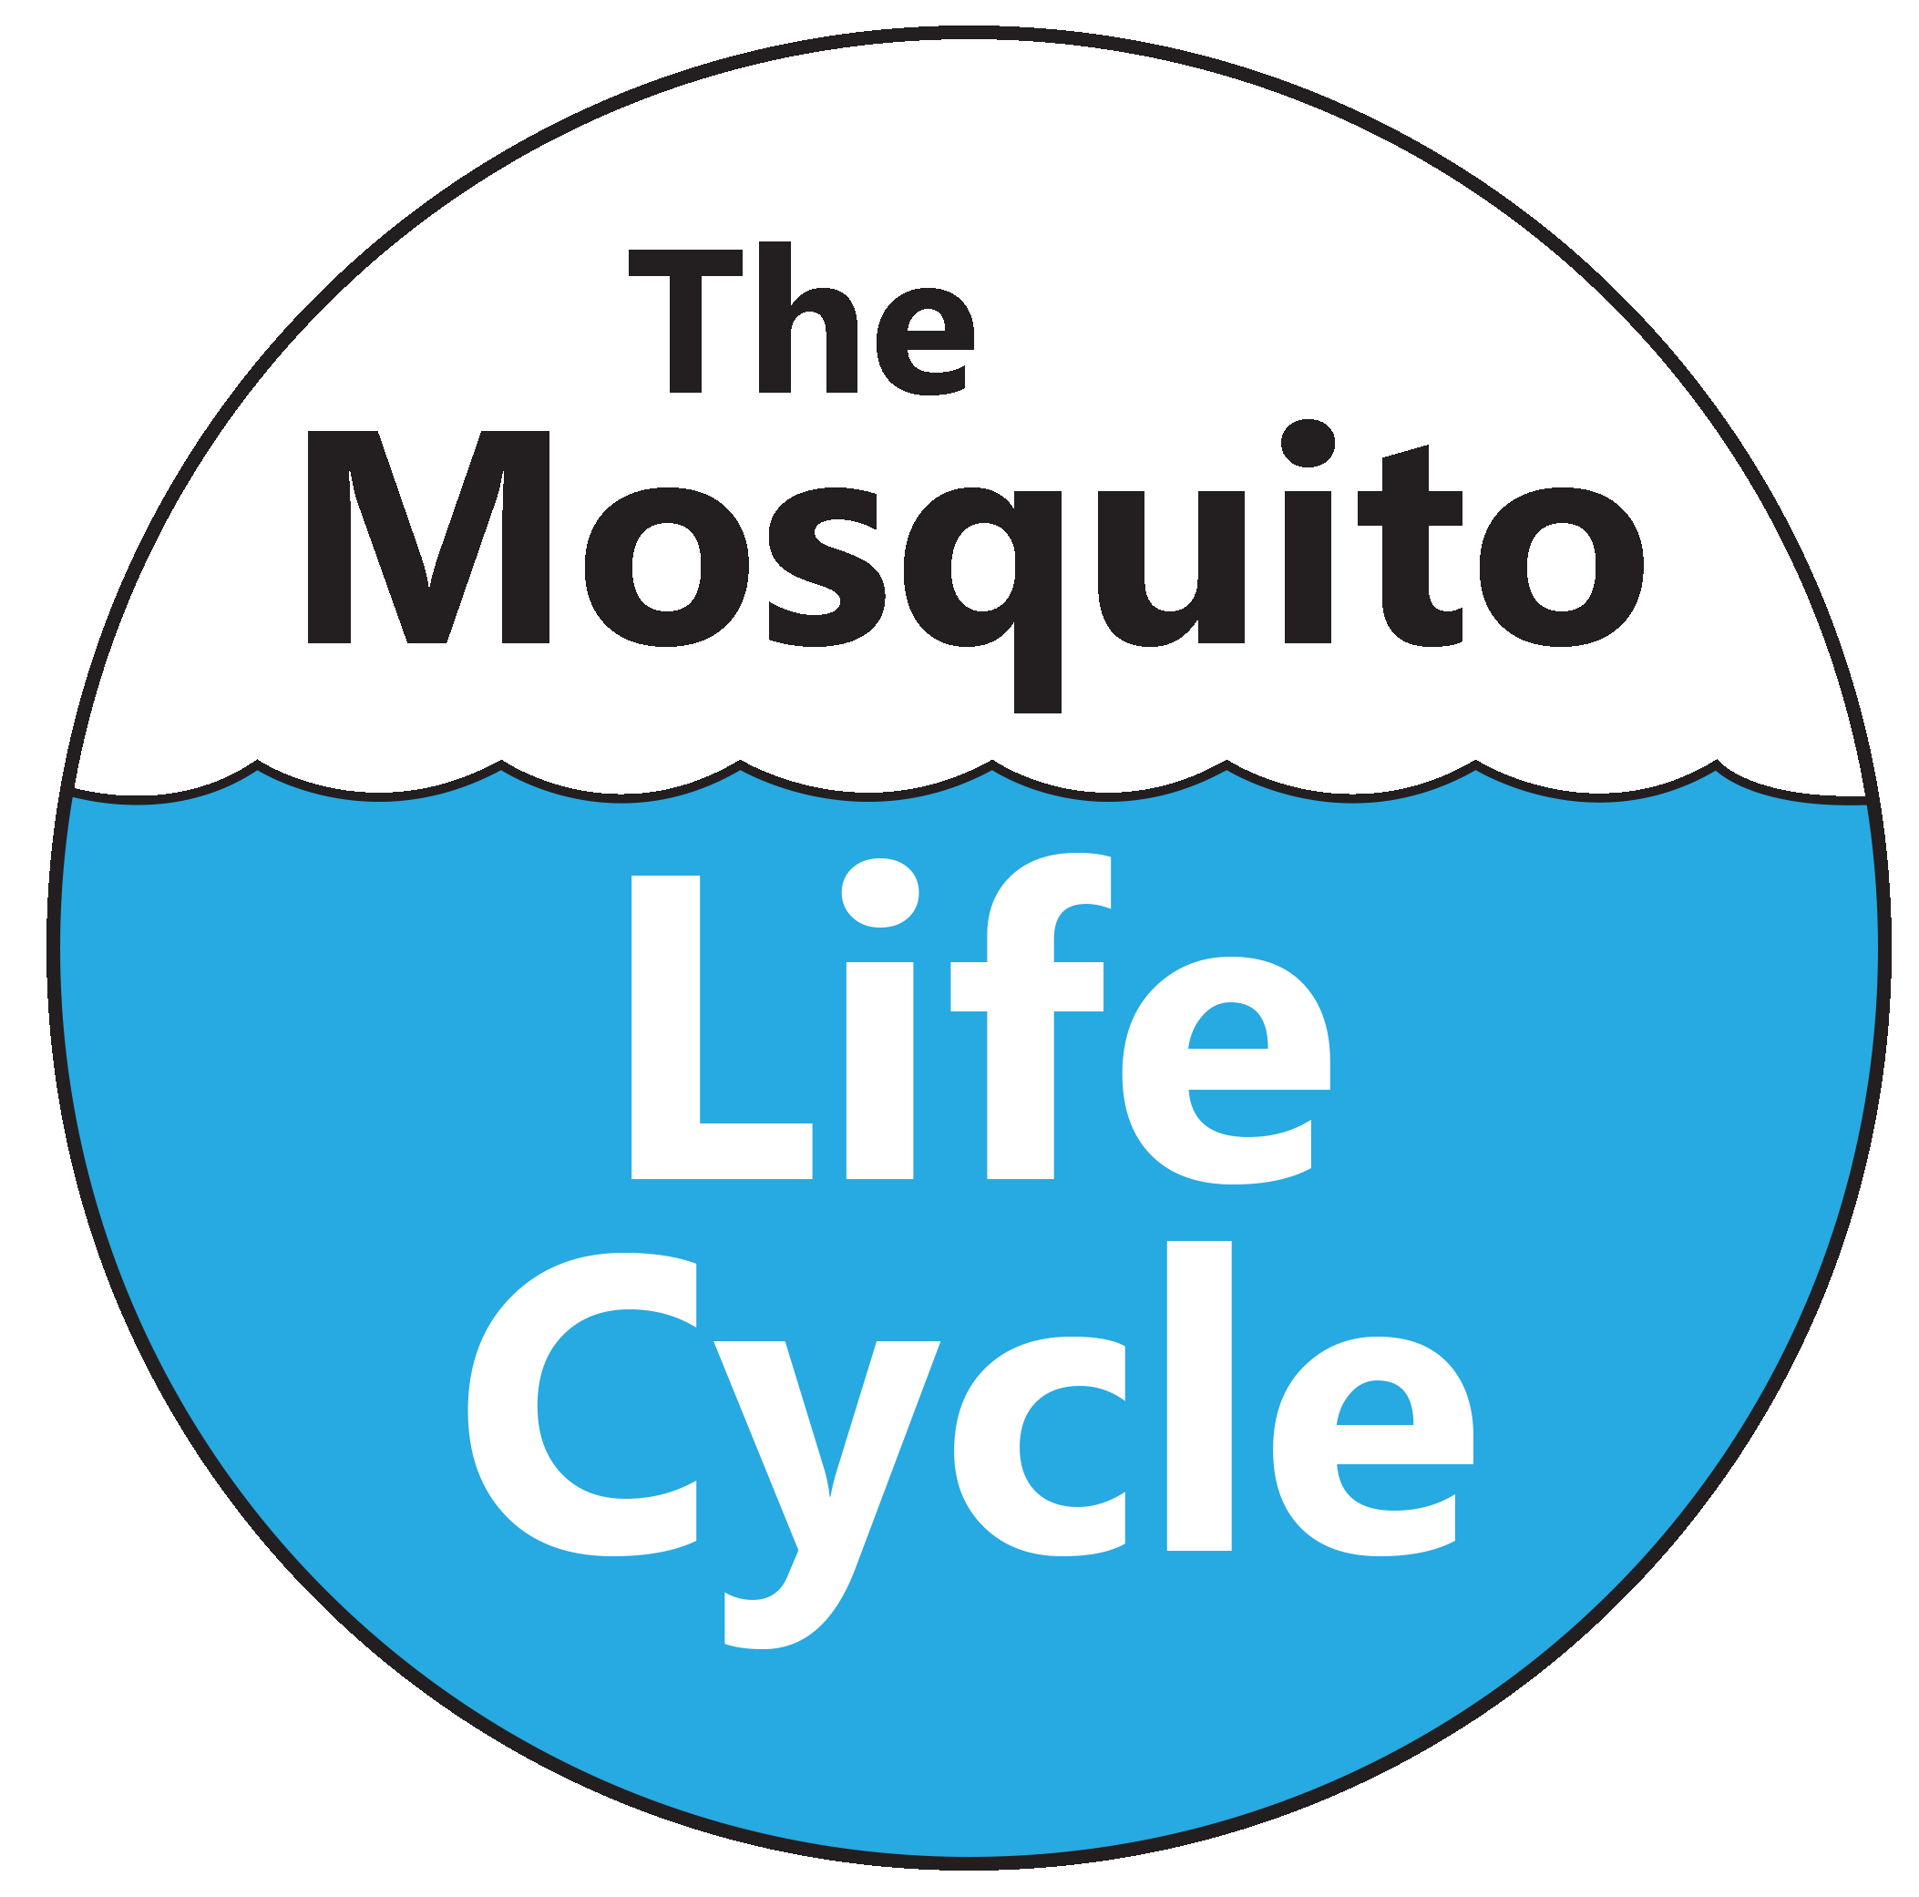
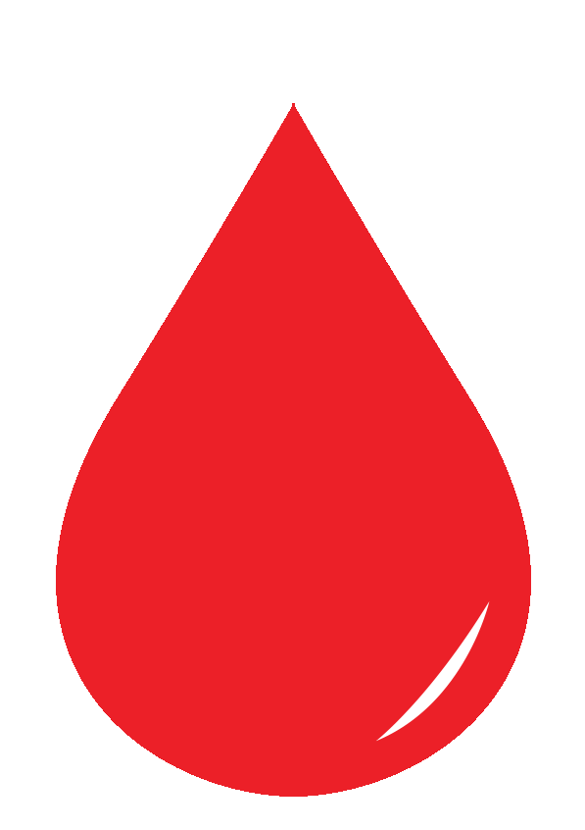
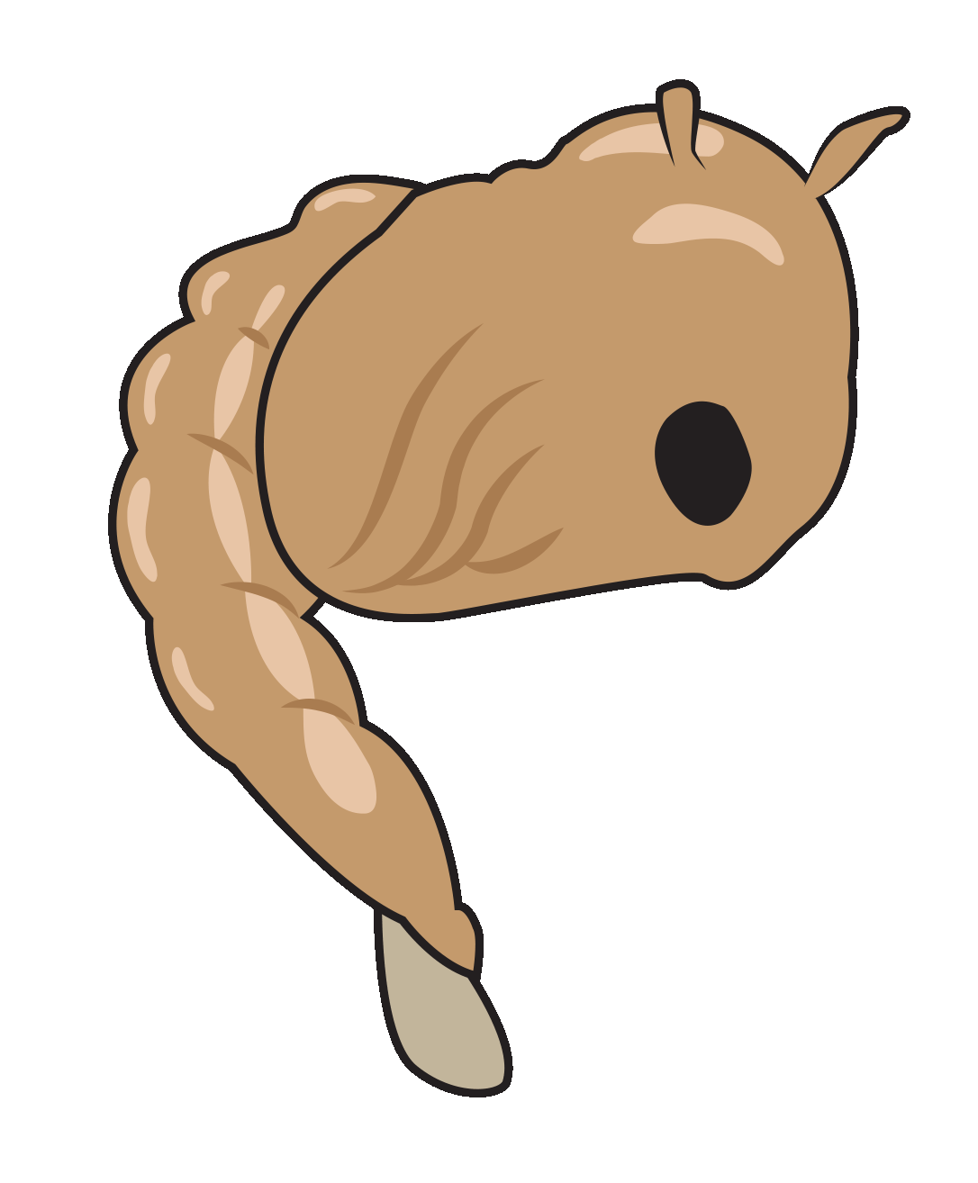
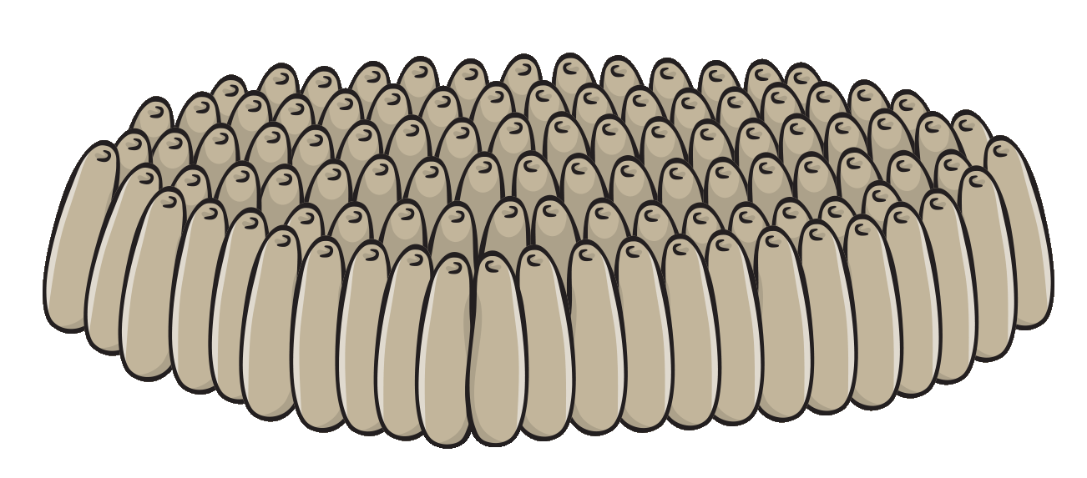
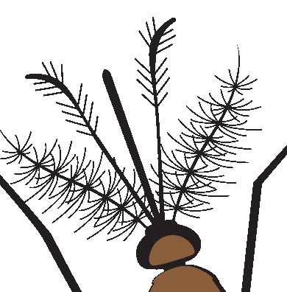
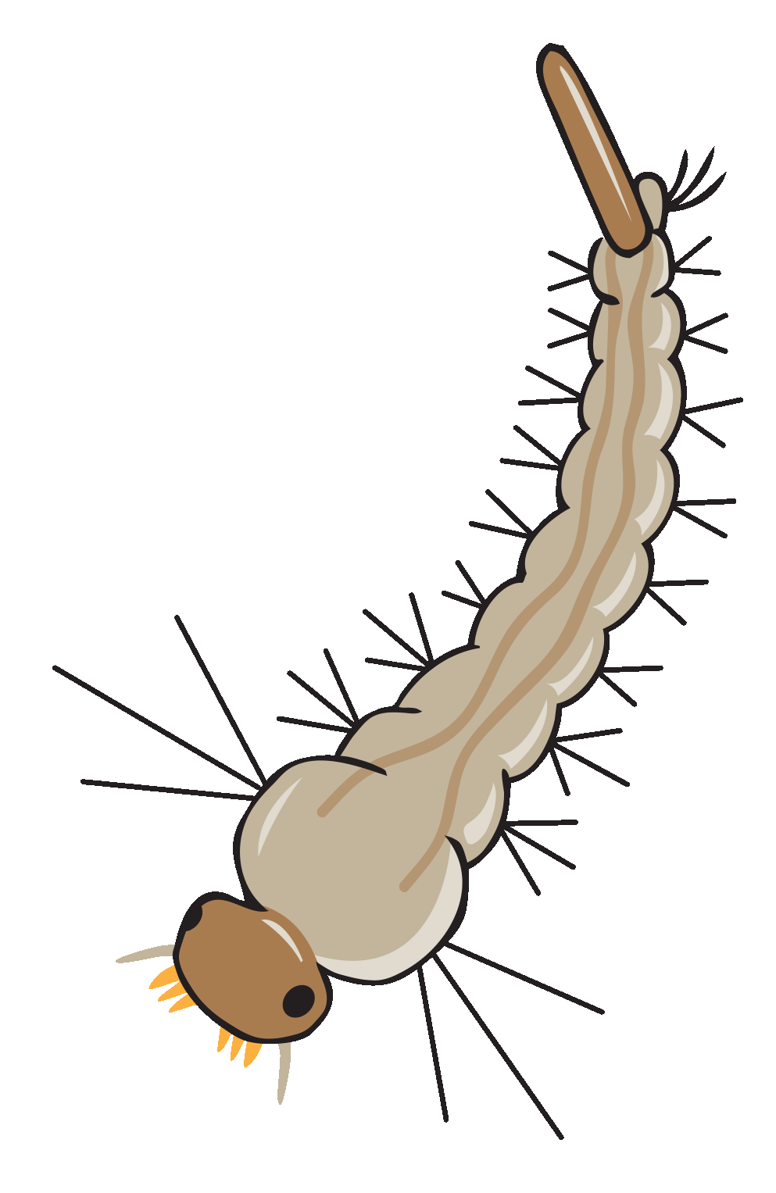
Adult
Nectar
Warmth
Blood
Pupa
Female
Eggs
Larva
Male

Slide 3
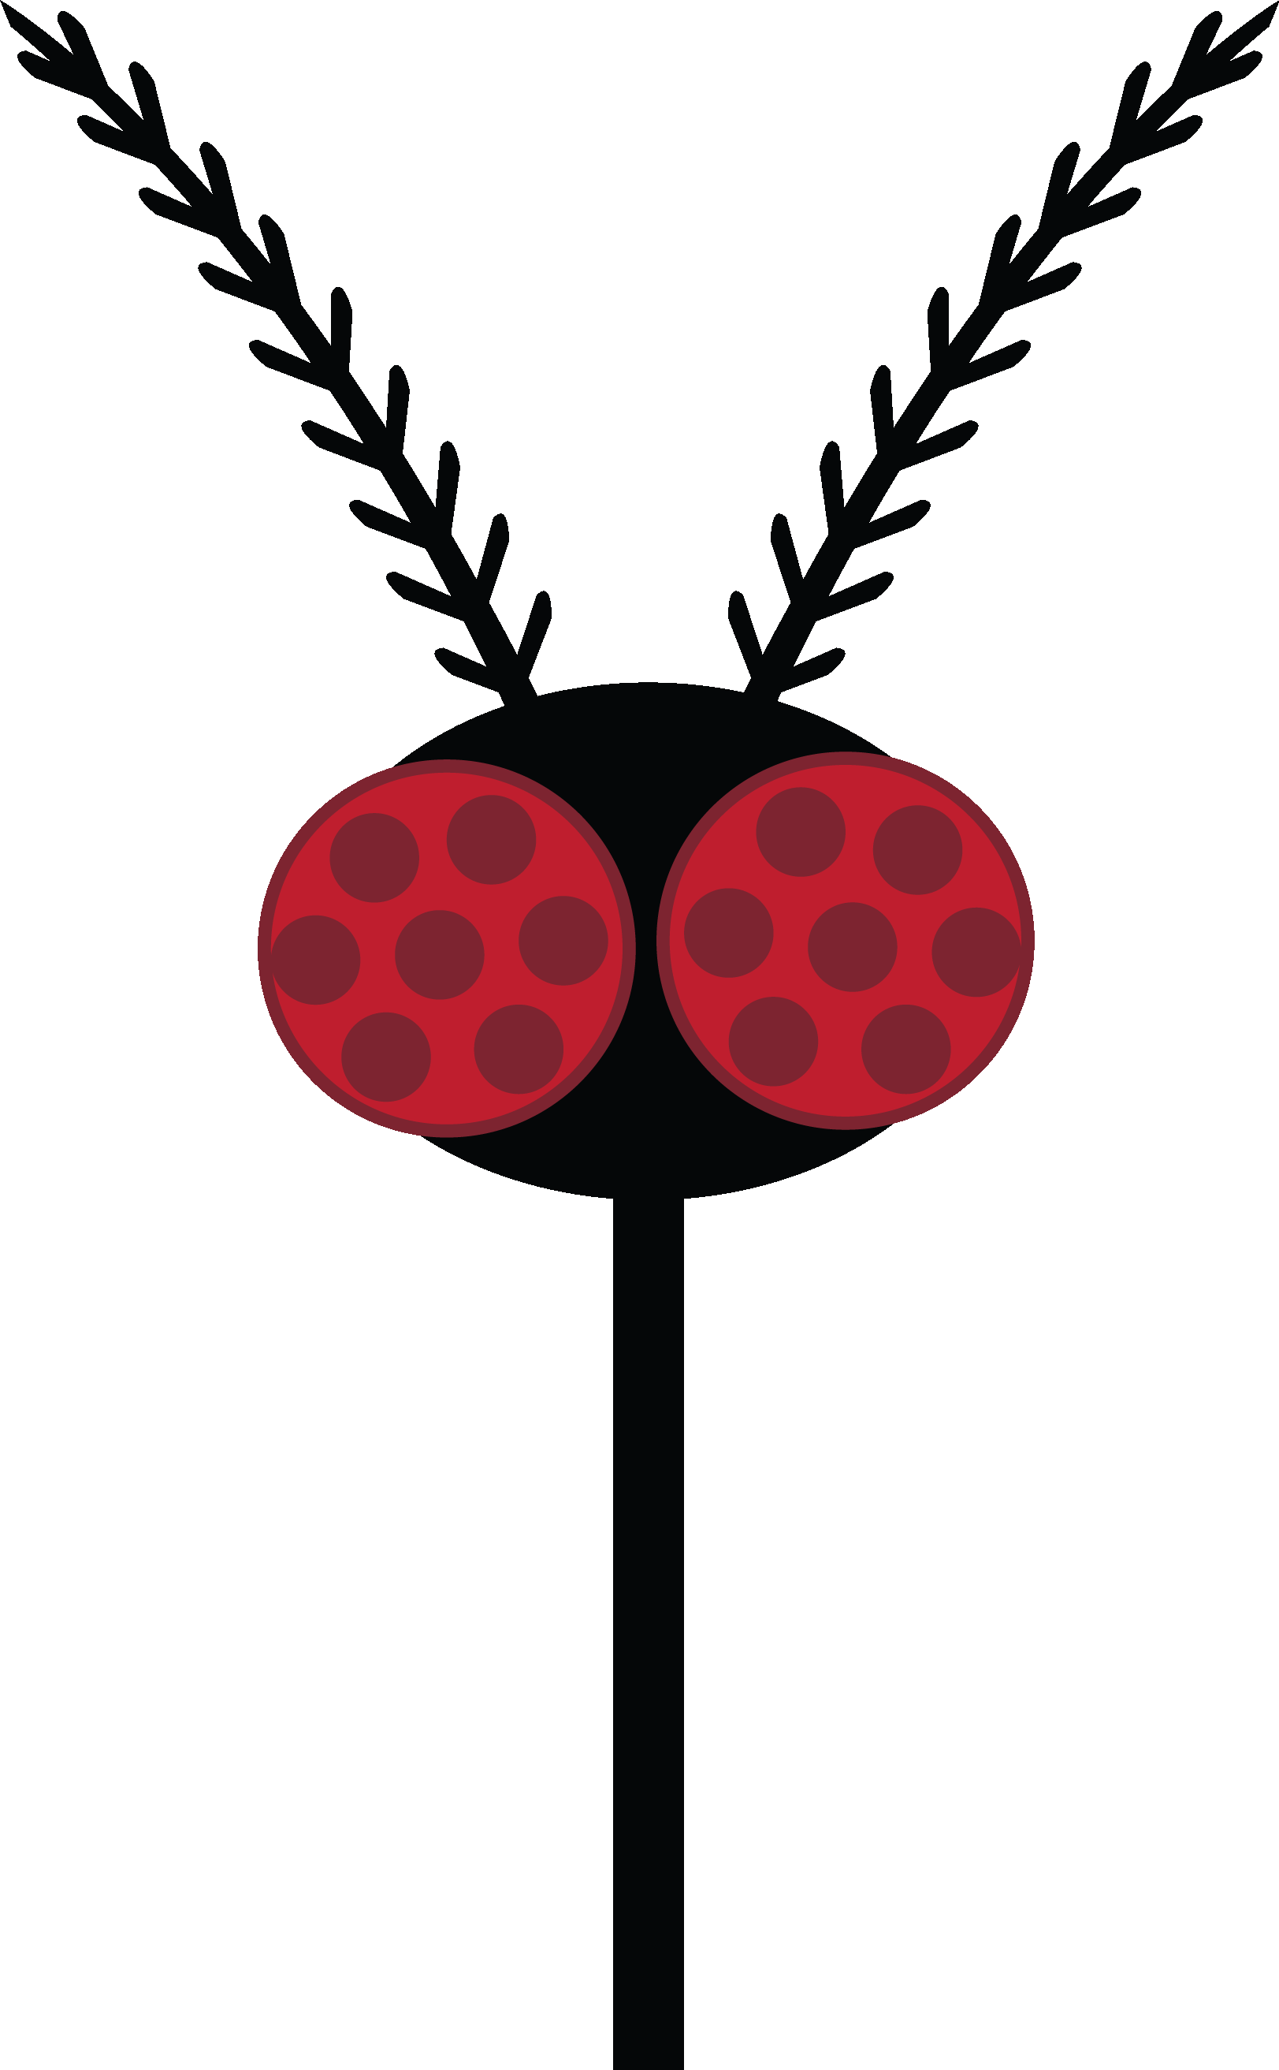
A few important diseases…
West Nile virus
Dog heartworm
Malaria
Zika virus
Yellow fever
Dengue fever
Chikungunya virus
Blood
Saliva
+ pathogens
Notes:
If mosquitoes just took a tiny bit of our blood we wouldn’t be that concerned with them. But they don’t just take our blood when they bite CLICK they also share their saliva. This is unfortunate because they can carry CLICK pathogens that can move from the mosquito into the host with the transfer of saliva. Animation appears. In many cases a virus but sometimes a parasite that lives inside us. Over 700,000 deaths from mosquitoes each year.

Slide 4


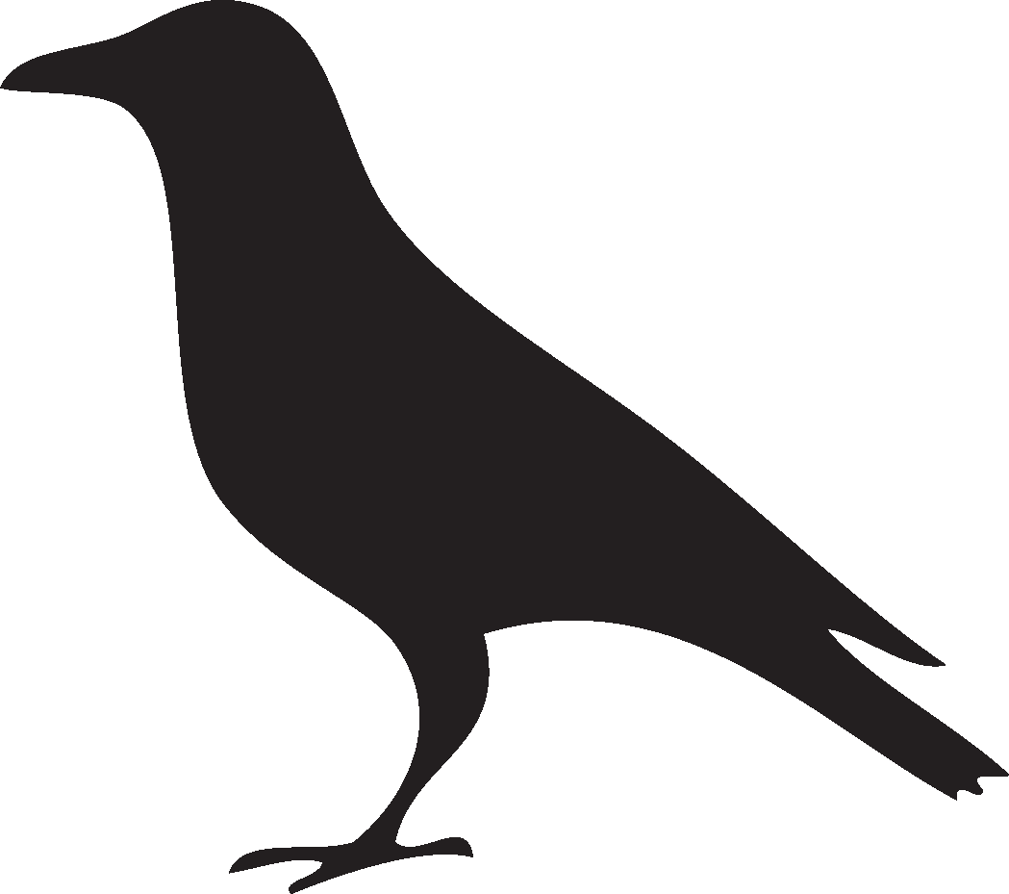
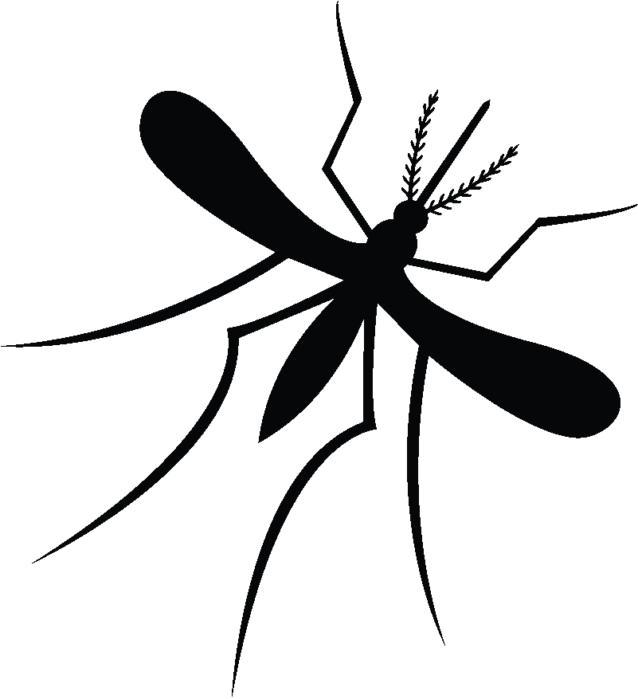

West Nile Virus
Bird
Mosquito
(Vector)
(Amplifier
Host)
Human
(“Dead end” host)
Notes:
In CA certain mosquitoes can spread west nile virus. Infected mos spreads it to a bird. Bird is amplifying host because virus multiplies to such a high concentration in bloodstream that an uninfected mosquito can acquire it from an infected bird. Certain local birds corvidae (crows, jays) also robins often die from virus. If you see a dead bird with no obvious signs of attack, don’t touch it but have someone call 877-WNV-BIRD to report it. Will bag it up and test for WNV.
Primarily a bird disease but can also infect bats, horses, cats, dogs, chipmunks, skunks, squirrels, rabbits, alligators and humans. When those other animals or humans get the virus, not everyone gets symptoms and even fewer get seriously ill or die. And we don’t end up with enough of it in our blood for an uninfected mosquito to get it from us (dead end). In the past there was so much WNV circulating in Ca that there were close to 800 known human cases and 31 deaths in 2014. Luckily last year we had 26 cases and no deaths (no cases in Sonoma/marin) but birds are rather famous for their ability to FLY, quite long distances so we do constant surveillance to protect people from this disease.

Slide 5
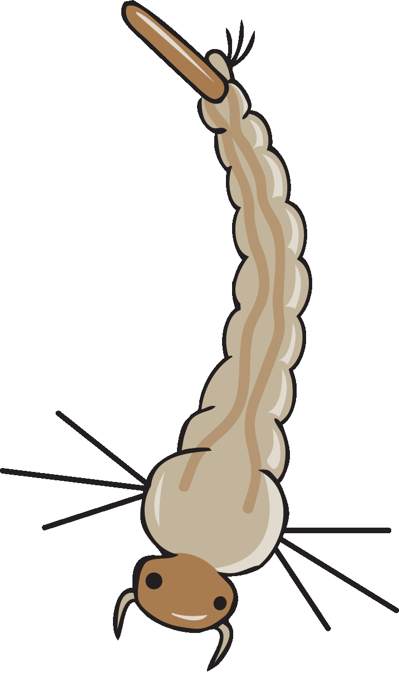
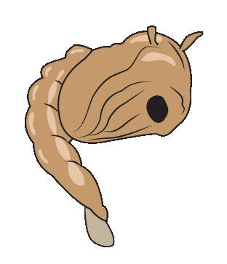
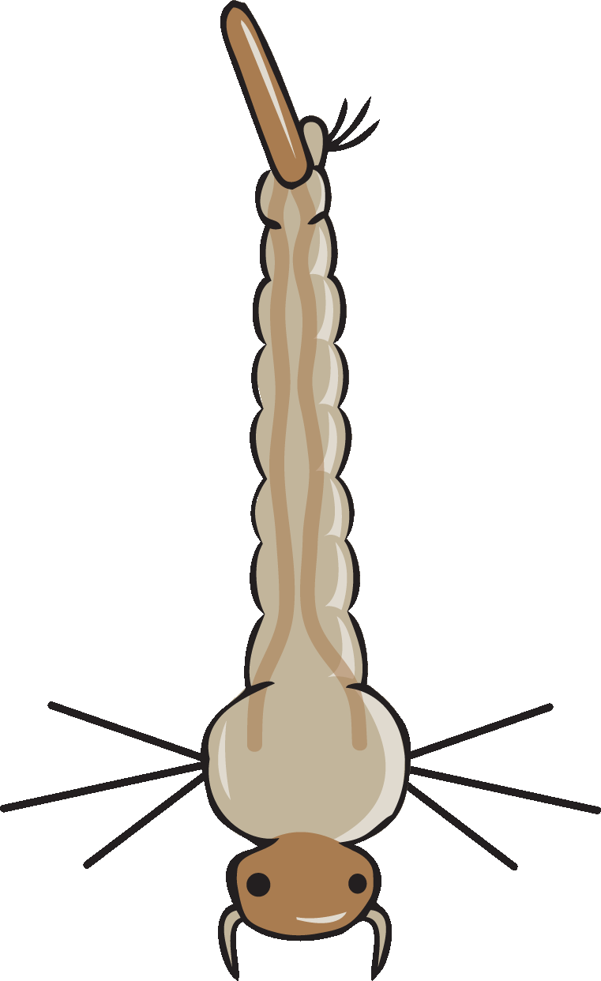
Mosquito Sources
A mosquito source is any place with standing water where mosquitoes may grow.

Slide 6
Notes:
13 places! What could we do about the gutter? The wagon? The trash bins? The pool? The dog dish? The pond and pool?

Slide 7
Solutions and Limitations
Change the habitat
Add a predator
Use bacteria
Protect yourself from adult mosquitoes
Some habitats are too big
Mosquitofish cannot be added to all habitats
Bacteria doesn’t work well in polluted habitats
People forget!
We need more solutions!

Slide 8
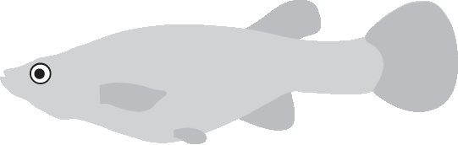
Where can Mosquitofish be used?
ONLY in water sources that are:
Human-made
Freshwater
Permanent, medium to large sources (more than a few gallons)
Notes:
Pass out fish/no fish signs to groups. They will ask themselves if the source can support mosquitofish or not.

Slide 9
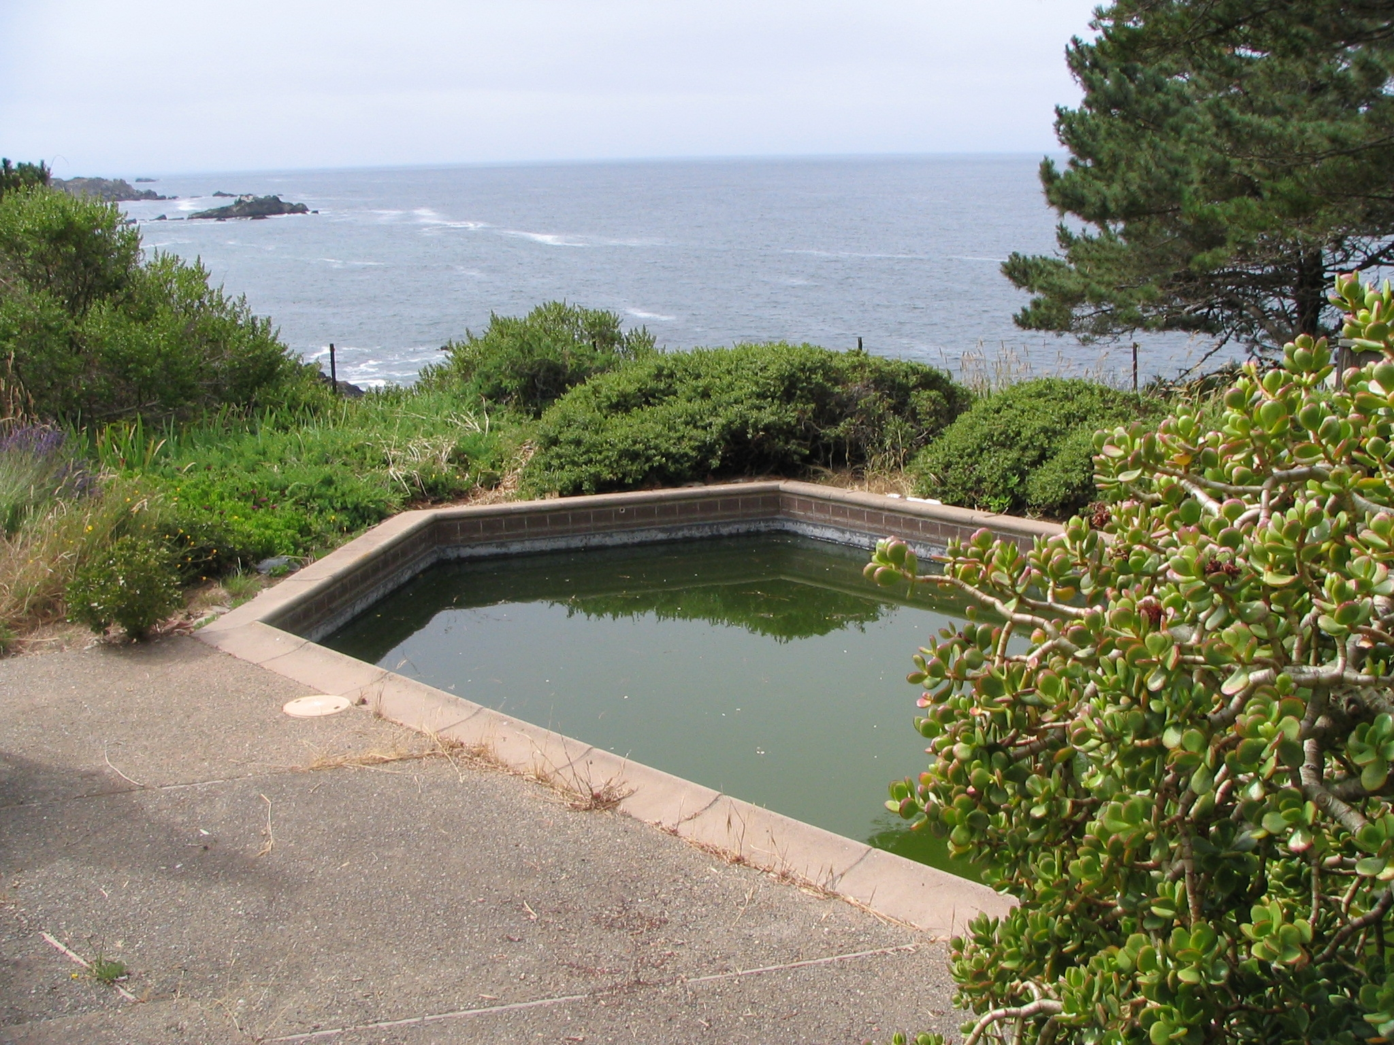
Green pool
Natural
Human made
Fresh water
Salty water
Small
Medium
Large

Slide 10
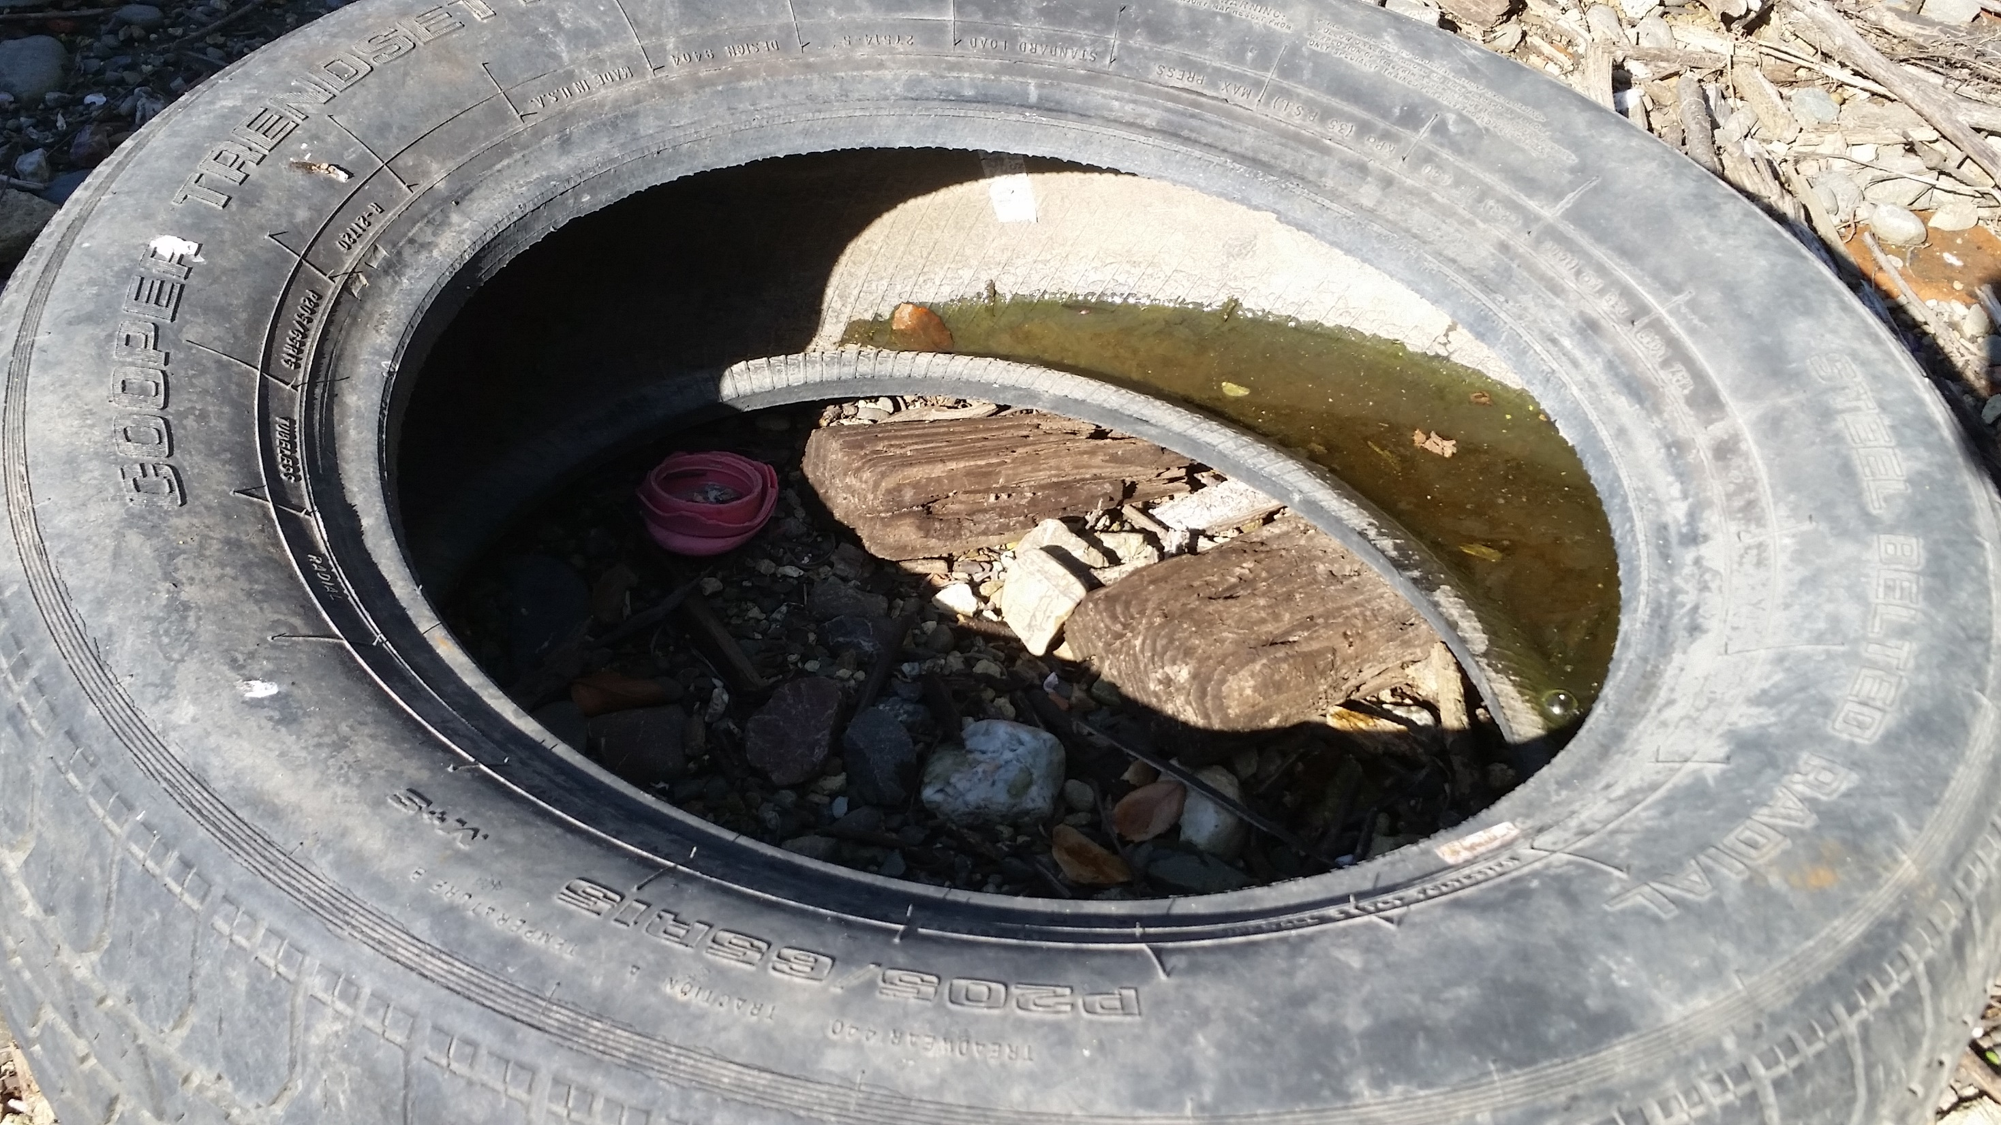
Tire
Natural
Human made
Fresh water
Salty water
Small
Medium
Large

Slide 11
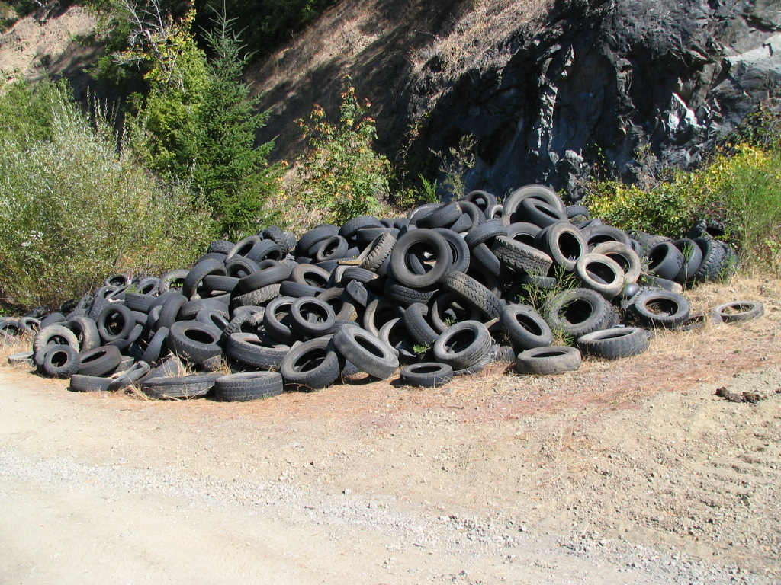
Lots of tires
Natural
Human made
Fresh water
Salty water
Small
Medium
Large

Slide 12
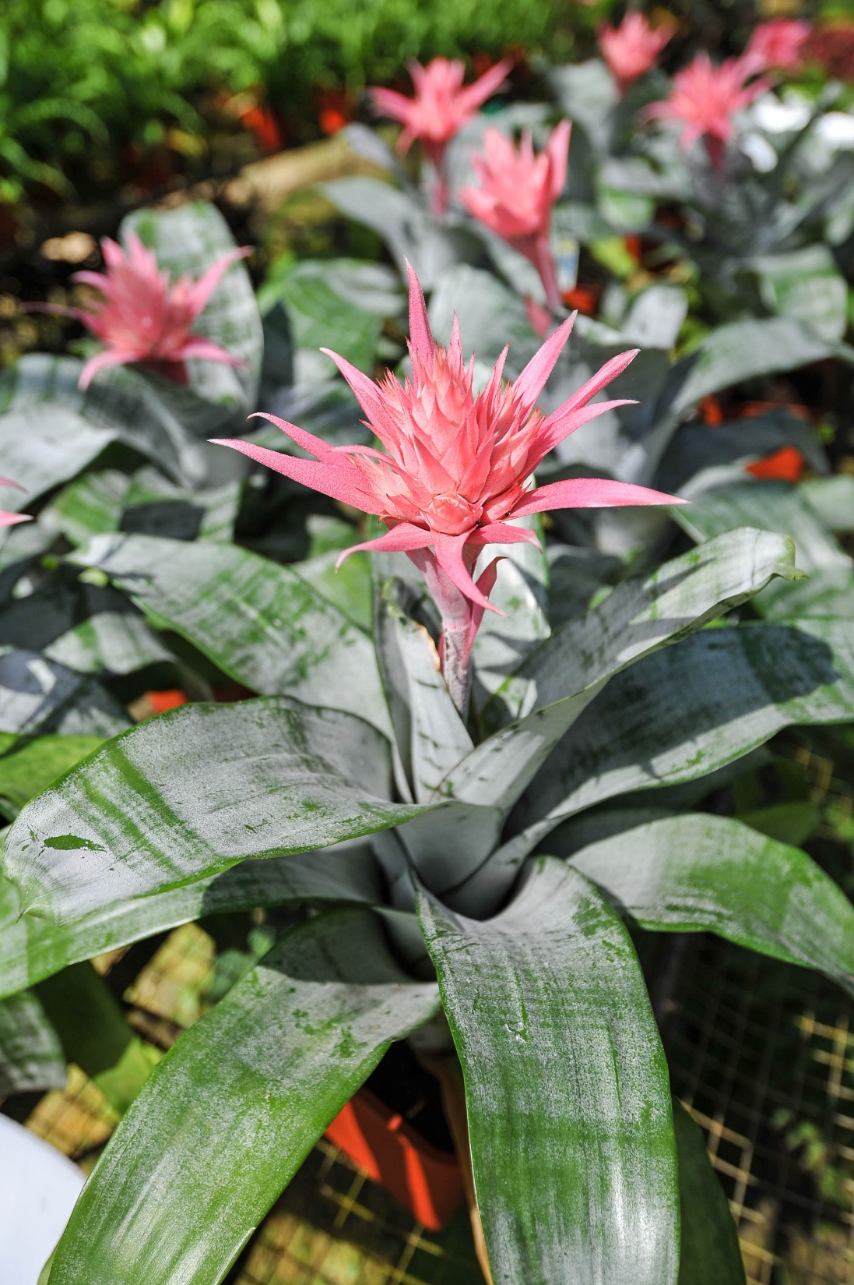
Bromeliads
Natural
Human made
Fresh water
Salty water
Small
Medium
Large

Slide 13
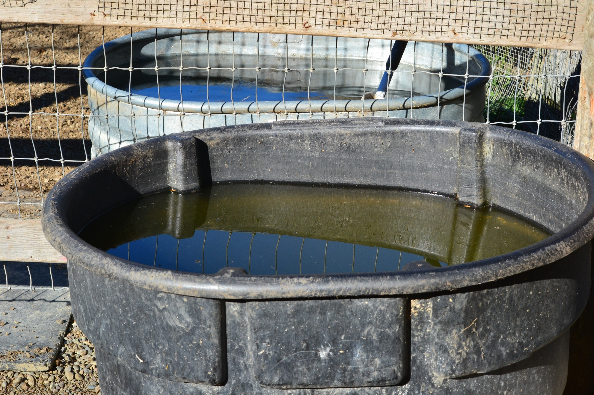
Trough
Natural
Human made
Fresh water
Salty water
Small
Medium
Large

Slide 14
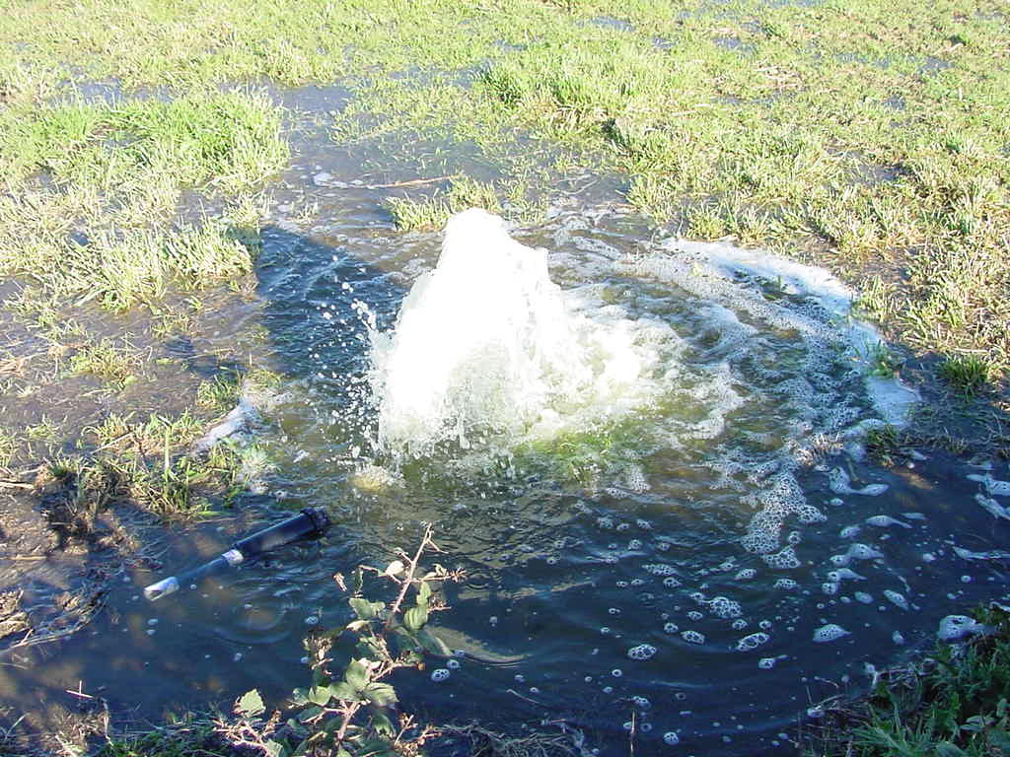
Broken pipe
Natural
Human made
Fresh water
Salty water
Small
Medium
Large

Slide 15
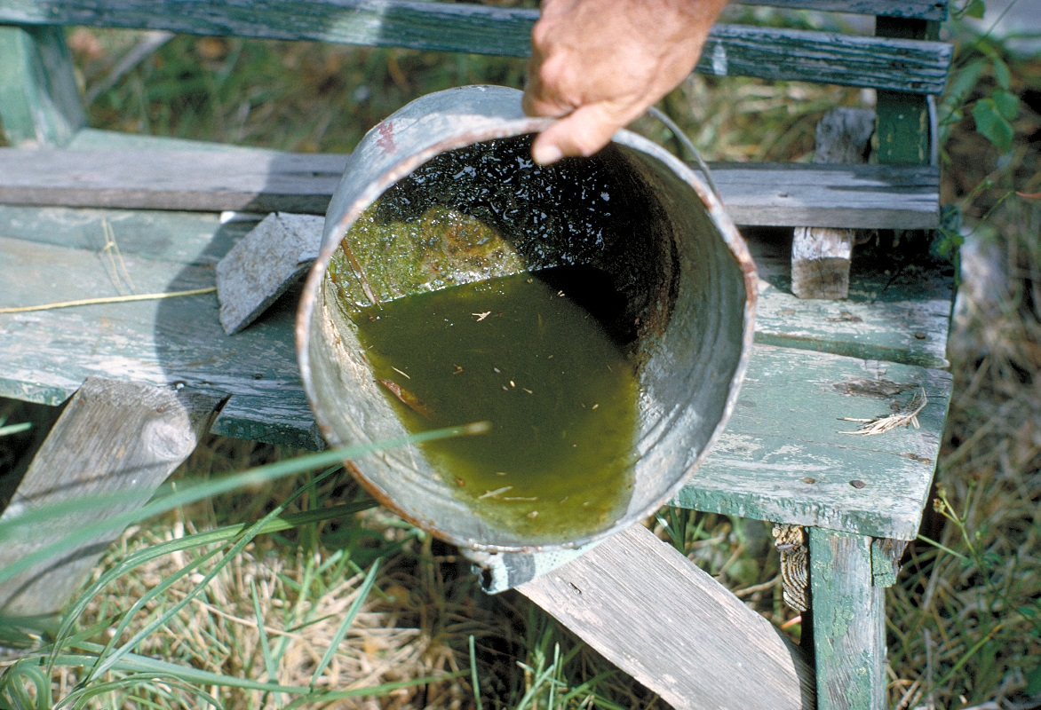
Bucket
Natural
Human made
Fresh water
Salty water
Small
Medium
Large

Slide 16
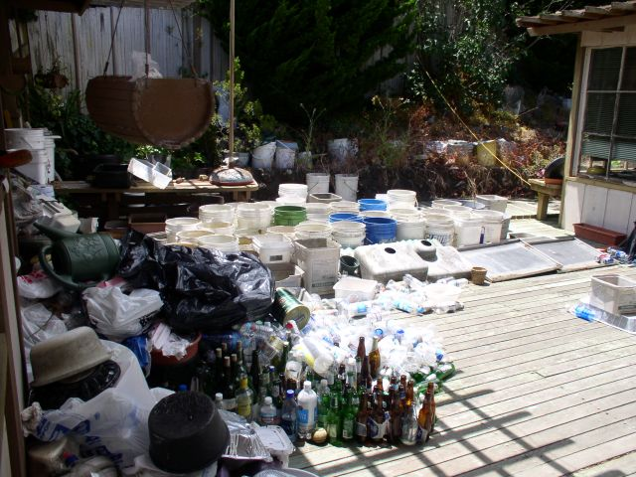
Junk
Natural
Human made
Fresh water
Salty water
Small
Medium
Large

Slide 17
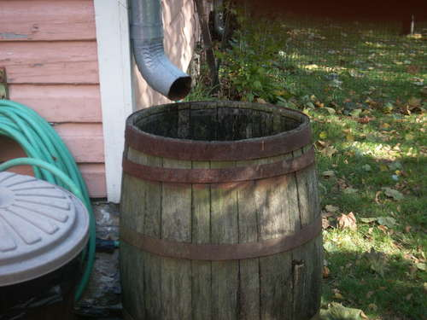
Rain barrel
Only use fish if the water is at least a foot deep
Natural
Human made
Fresh water
Salty water
Small
Medium
Large

Slide 18
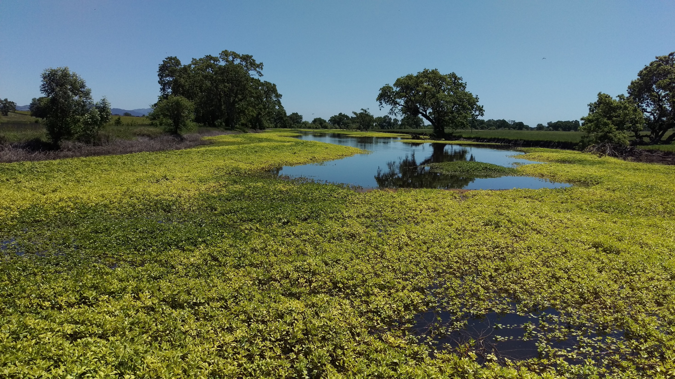
Wetlands
Natural
Human made
Fresh water
Salty water
Small
Medium
Large

Slide 19
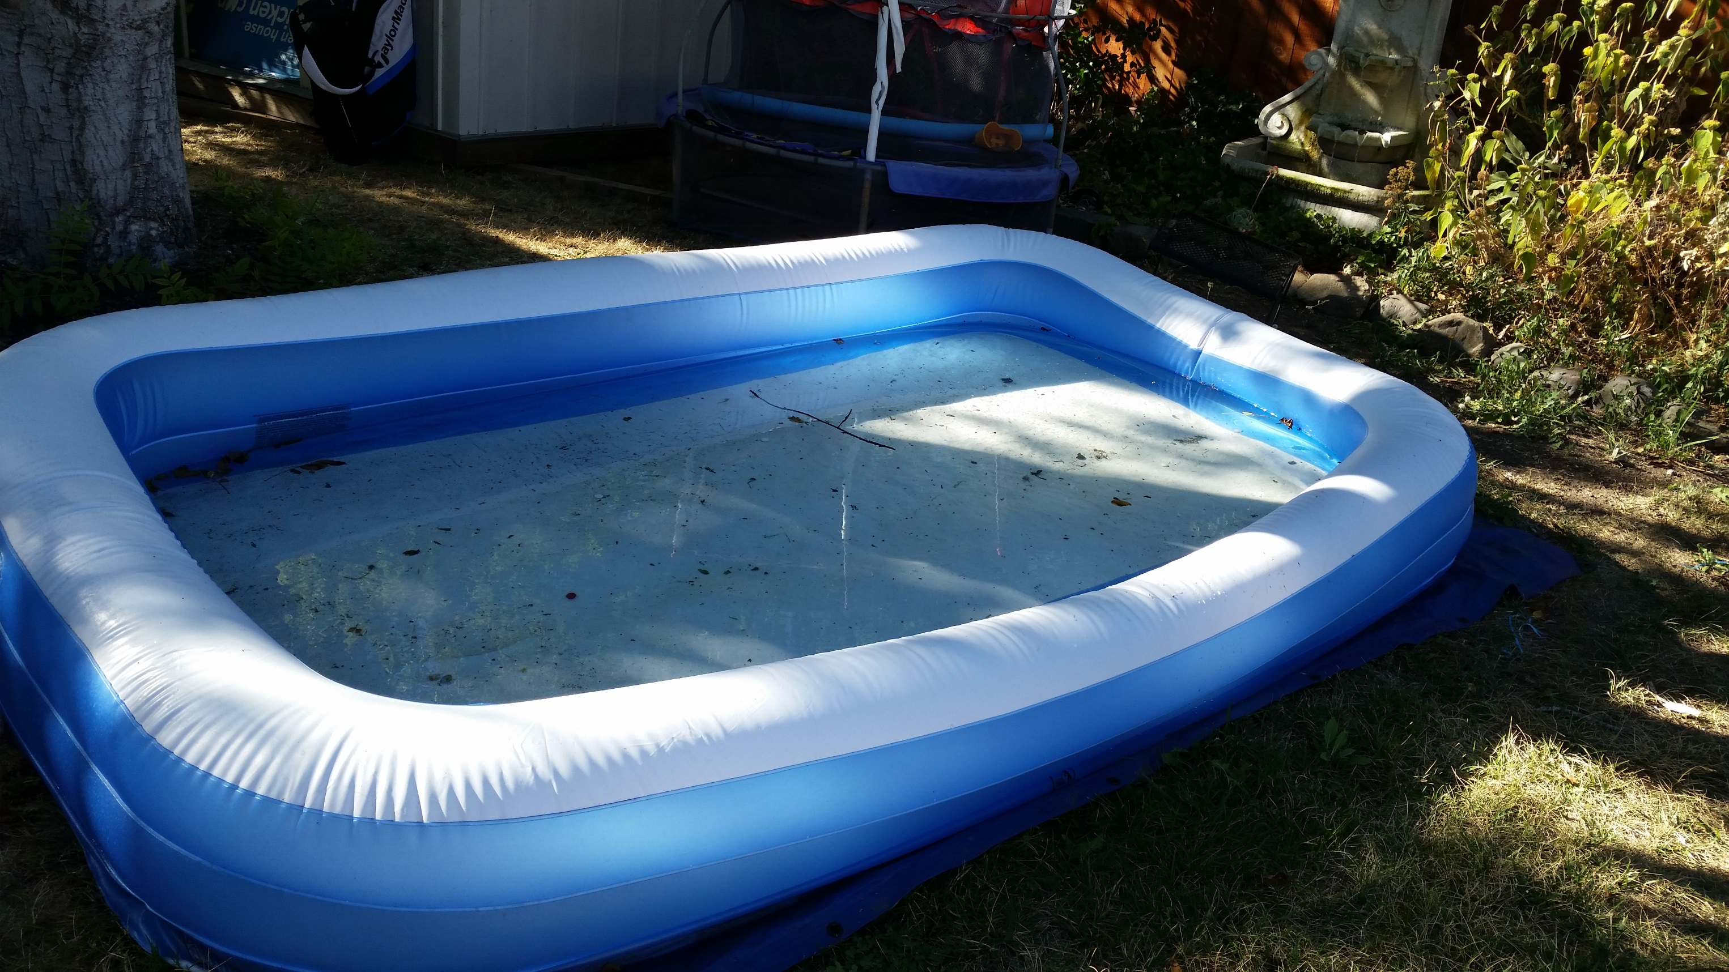
Kiddie pool
Natural
Human made
Fresh water
Salty water
Small
Medium
Large

Slide 20
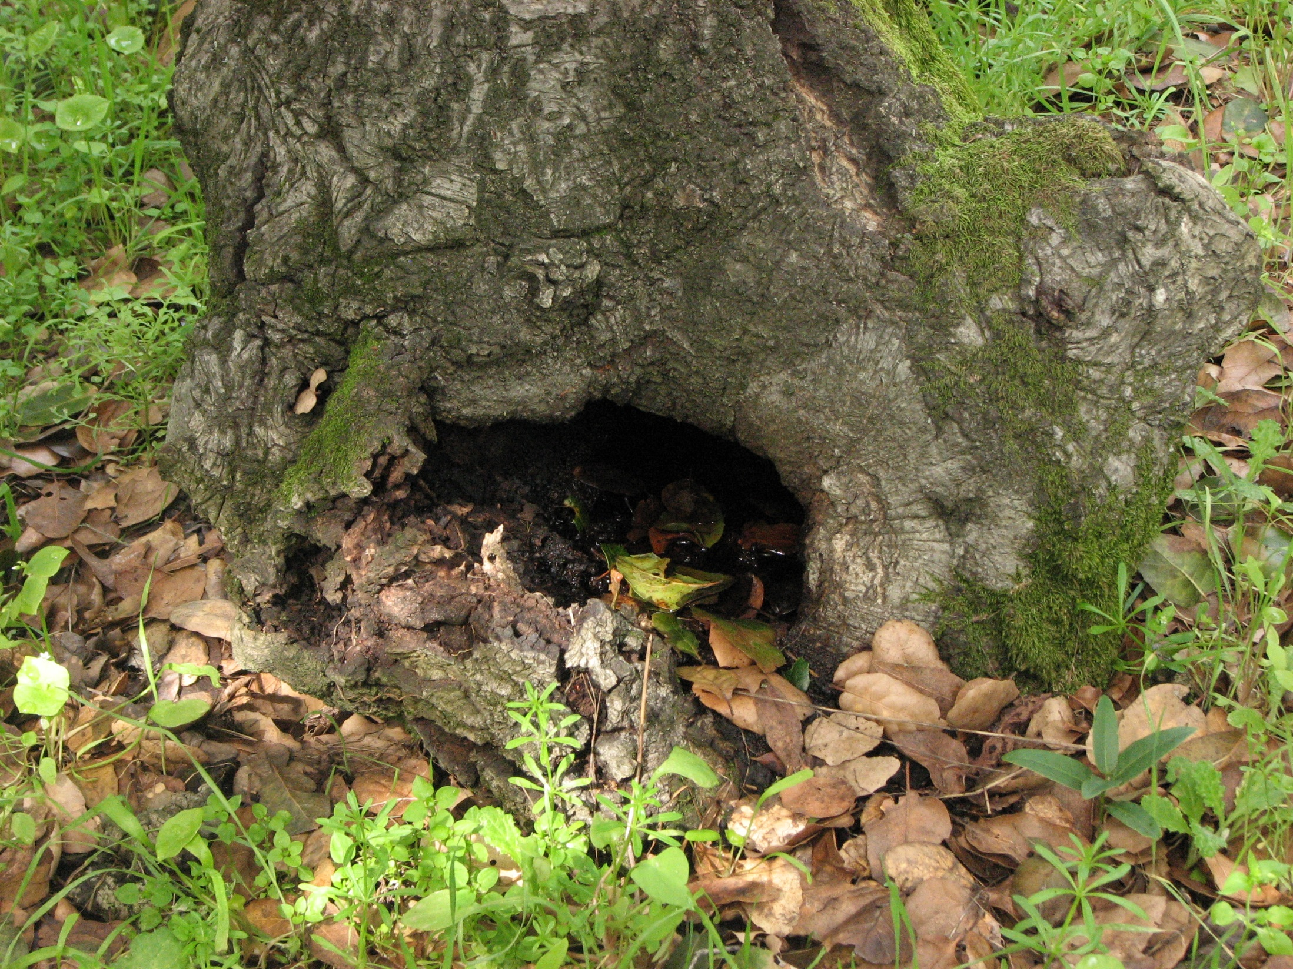
Treeholes
Natural
Human made
Fresh water
Salty water
Small
Medium
Large

Slide 21
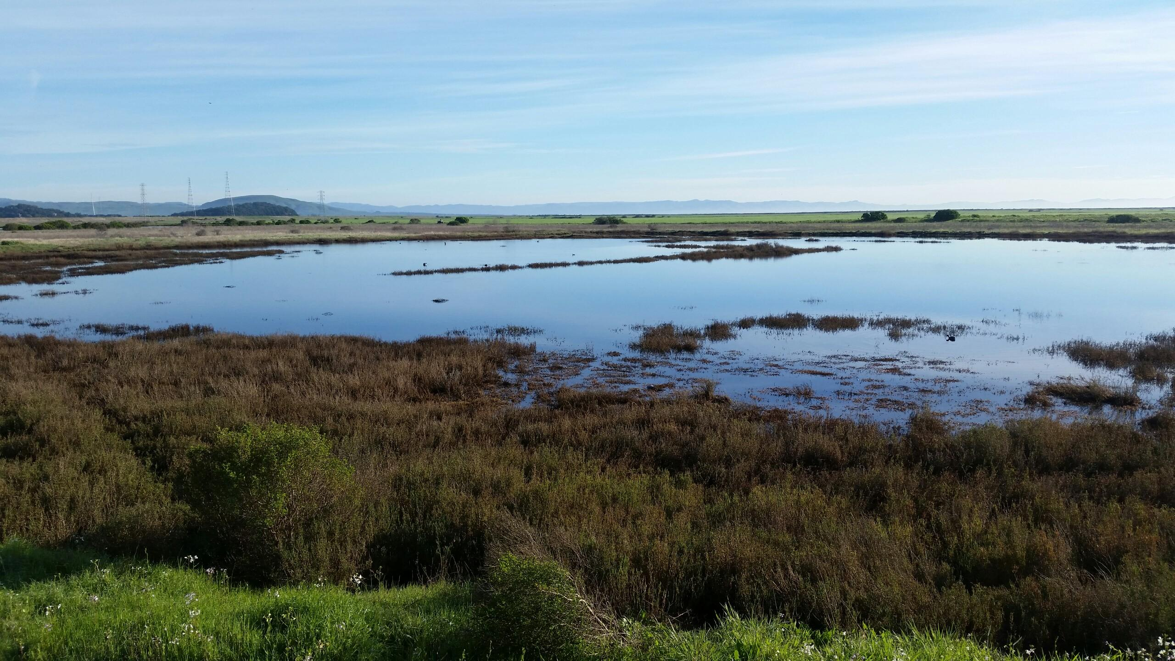
Salt marsh
Natural
Human made
Fresh water
Salty water
Small
Medium
Large

